Slide 1

Java Final Project — XDF 2DGraphics
Group Member:
Bonan Chen
Jiahui Zhang
Yujie Ren

Slide 2
Mission
Read in SVG file
Parse SVG file and extract information
Draw SVG file on the screen

Slide 3
SVG
Scalable Vector Graphics which is XML-based vector image format
SVG is completely customizable, and do not lose detail as their size increases
Java do not provide native SVG support

Slide 4
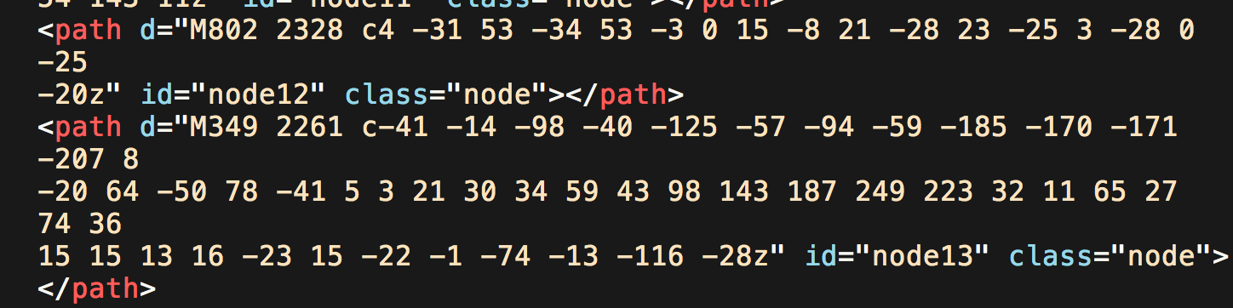
Import SVG
Read in SVG file
Identify shape in SVG
Call parse class to extract information from SVG
Call shape class to draw SVG

Slide 5
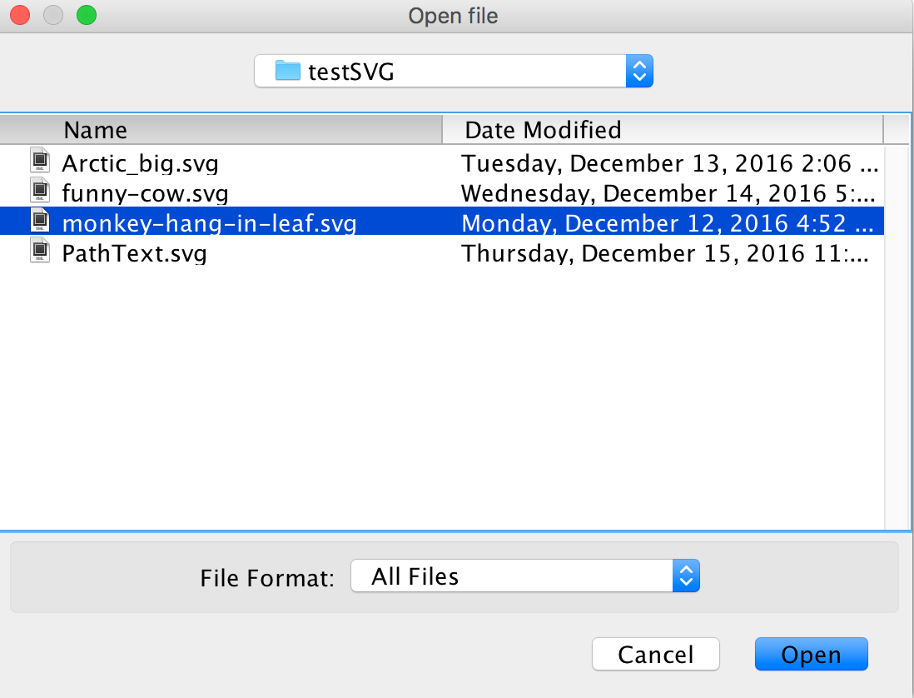
Function1, import SVG into document viewer

Slide 6
Parse
Use regex to extract attributes from each shape
Save these attributes into variables and create get method to get them

Slide 7
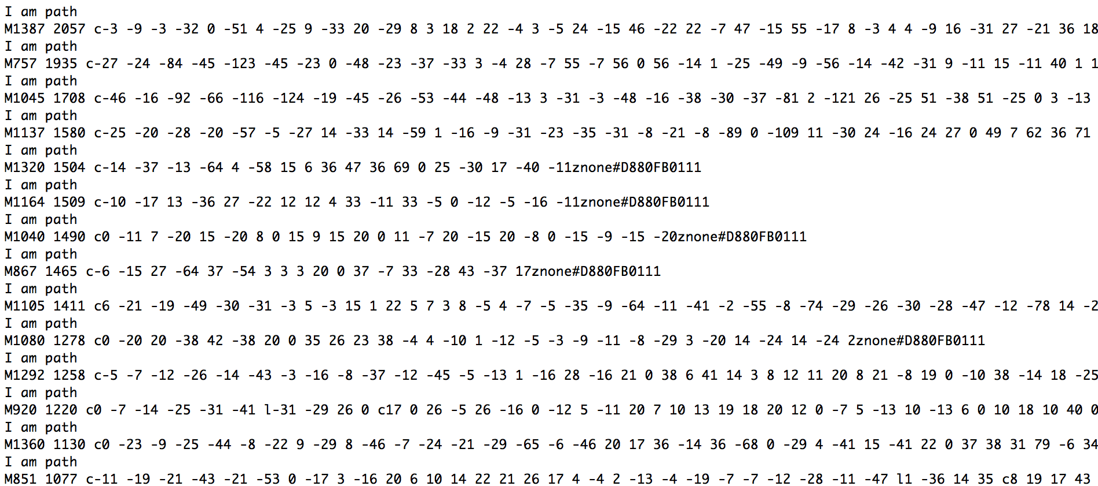
Function2, parse SVG file and extract shape information

Slide 8
Shape
Import SVG class passes arguments into Shape class
Shape classes call method in the Batik library to draw themselves.
Save the shapes into DOM tree
Add the tree to JSVG Canvas to display SVG

Slide 9
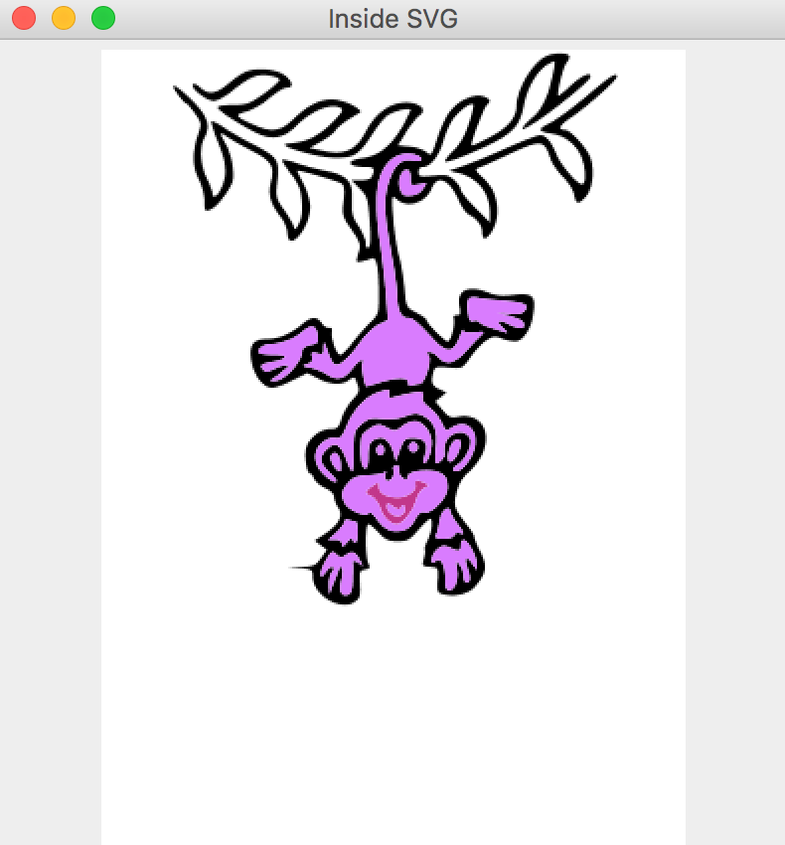
Function 3, draw SVG on the screen

Slide 10
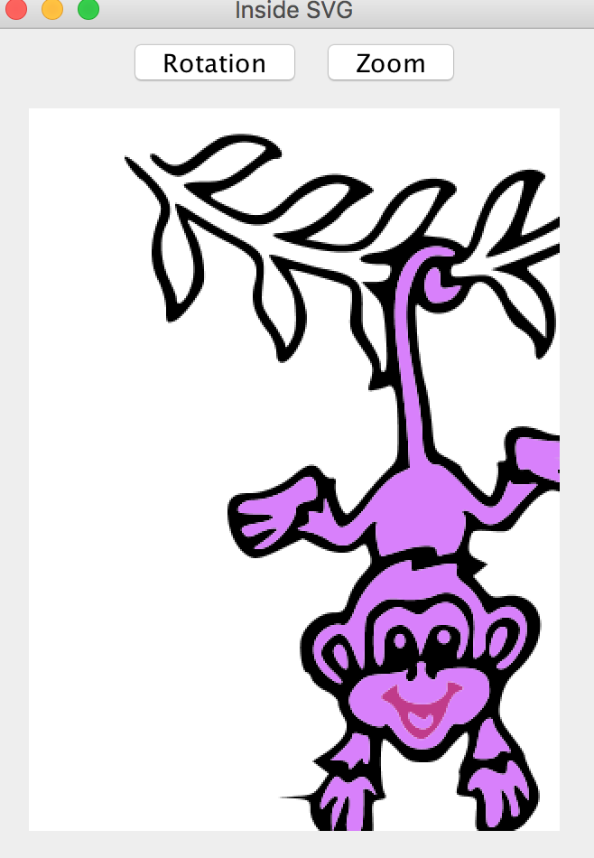
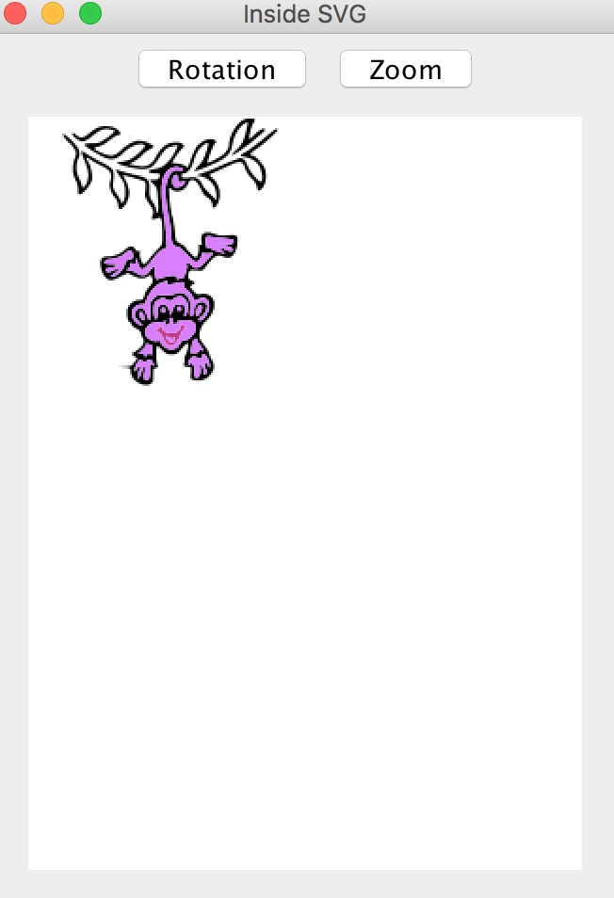
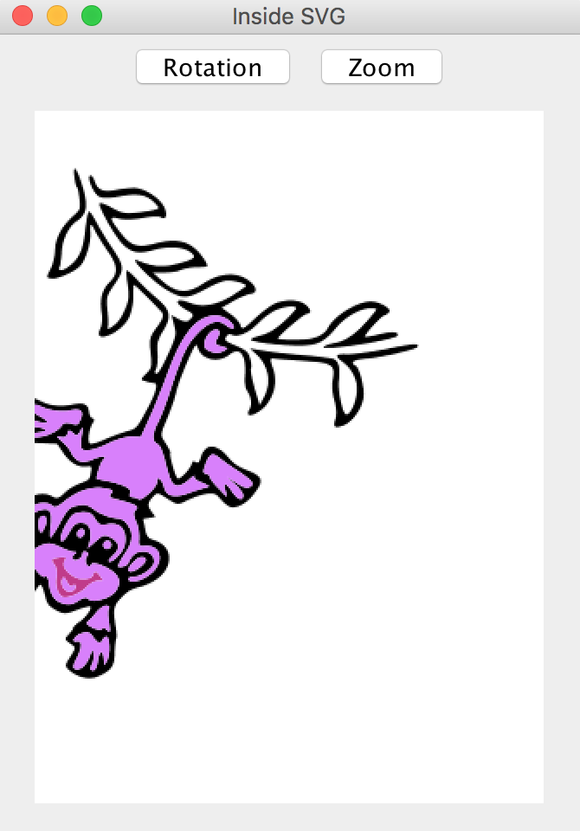
Function 4, implement SVG file zoom in, zoom out and rotation

Slide 11
Thank you

